Slide 1
INFINITY GATED COMMUNITY -T2S3 team(no. 29)
-Sruthi Bellamkonda
-Tara Canugovi
-Tulasi Kota
-Sravani Yada
-Swetha Gorla

Slide 2
AIM
To make things easy and efficient in a community by using a portal which can be accessed by all residents.

Slide 3
Objectives:
People joining the community should be able to register into the portal.
The registration request should be accepted by the security admin of the portal.
People can post the meeting into the portal.
The details of meeting should be visible to all families of the community.
People can raise concern in the portal.
The concerns should go to respective department.

Slide 4
MODULES USED IN THIS GATED COMMUNITY

Slide 5
Registration form Registration form Registration form Registration form Registration form Registration form Registration form
1.REGISTRATION FORM
Owner
Tenant

Slide 6
2.LOGIN

Slide 7
3. Complaints/Suggestions Form
Electrician
Plumber
Telephone
Garbage collector

Slide 8
General Complaints
No water supply
No current supply
Security issues
Community Hall maintenance
Cleanliness Issues
Other problems

Slide 9
4.Meeting Proposals
(New Ideas and concerns)
Reasons for having a meeting can be
Problems
Cultural activities
Festival activities
Fund collection

Slide 10
5.Sending Notifications to all the residents if there is any meeting or other notifications

Slide 11
FUNCTIONS OF ACTORS INVOLVED IN The Infinity Gated community MODULE

Slide 12
Functions of admin
Login
Receive complaints
Send complaints to respective department
Attend meetings
Collect Funds
Send notifications to all residents
Conduct meetings
Suggestions to avoid problems

Slide 13
Functions of residents
File compliants.
Suggests meeting proposals.
Other suggestions.
Pay maintanence Fee.
Attend meetings.

Slide 14
HOME PAGE

Slide 15
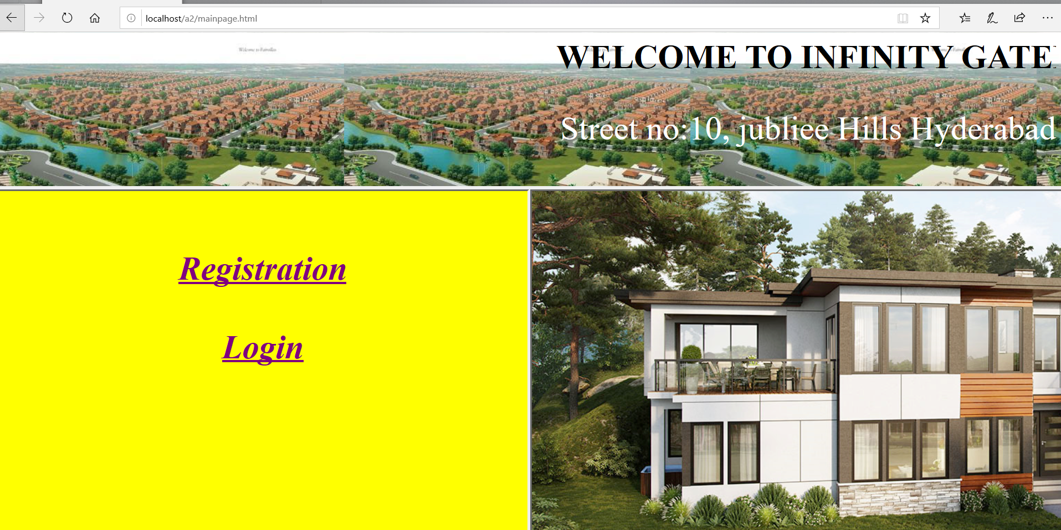

Slide 16
Registration page

Slide 17
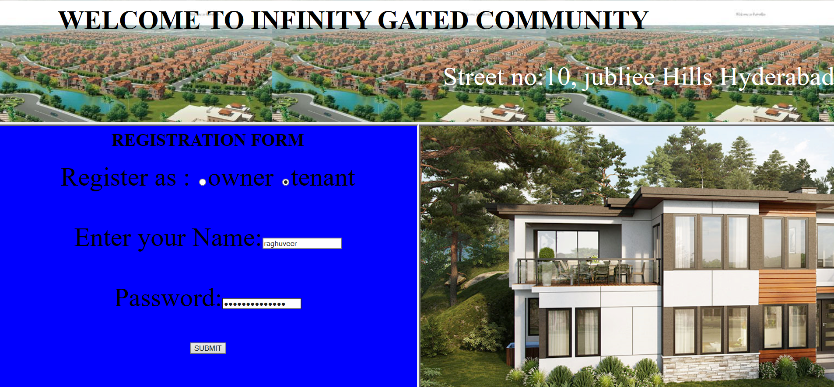

Slide 18
The credentials will be sent to admin and are validated.

Slide 19
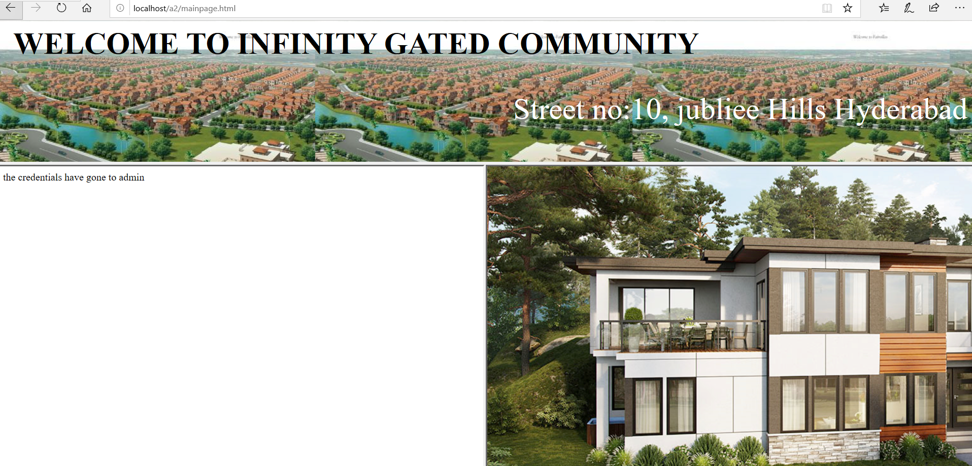

Slide 20
LOGIN page

Slide 21
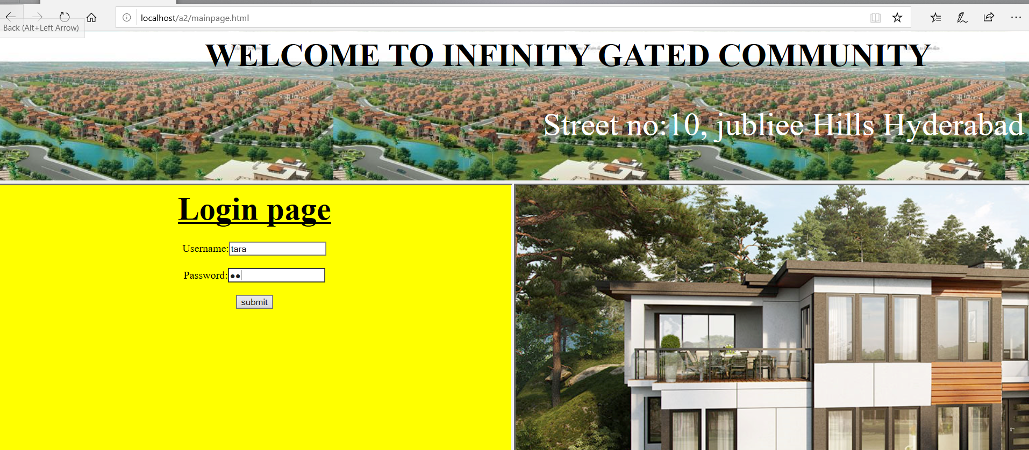

Slide 22
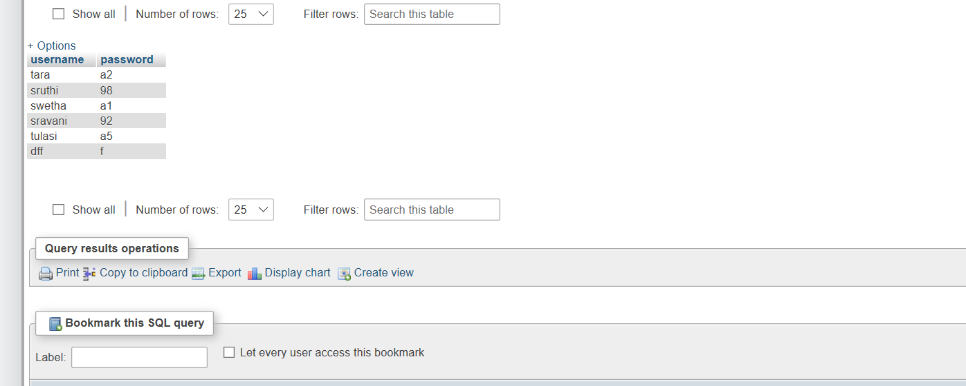

Slide 23
If the entered login credentials are valid, then it is directed to a page where the residents are allowed to post complaints, suggestions, propose meetings.

Slide 24
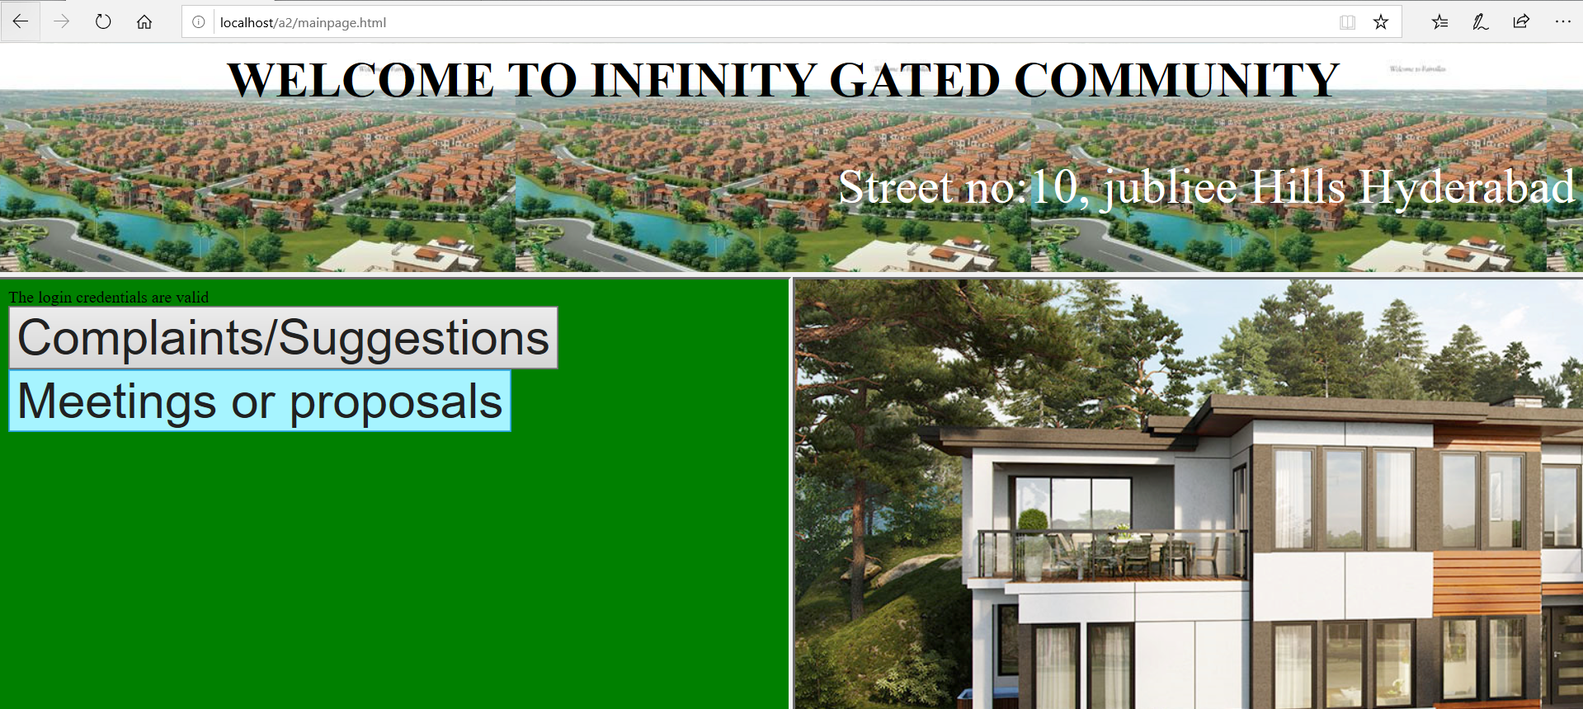

Slide 25
Complaints / suggestions page

Slide 26
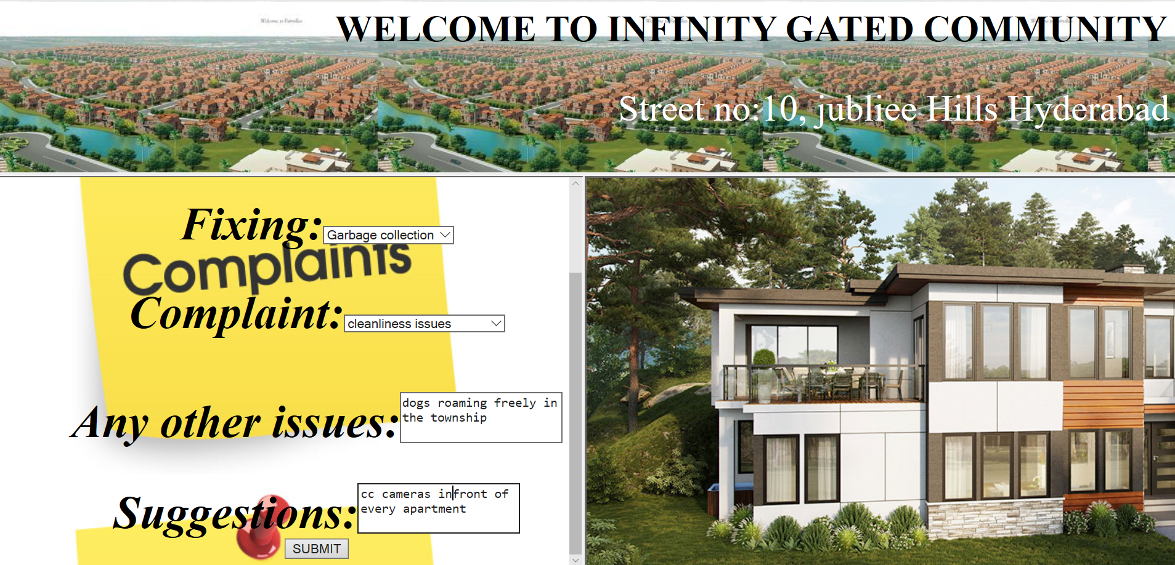

Slide 27
In this page a resident can file his issues regarding the gated community and if the complaints are registered the message “done” is being displayed.

Slide 28
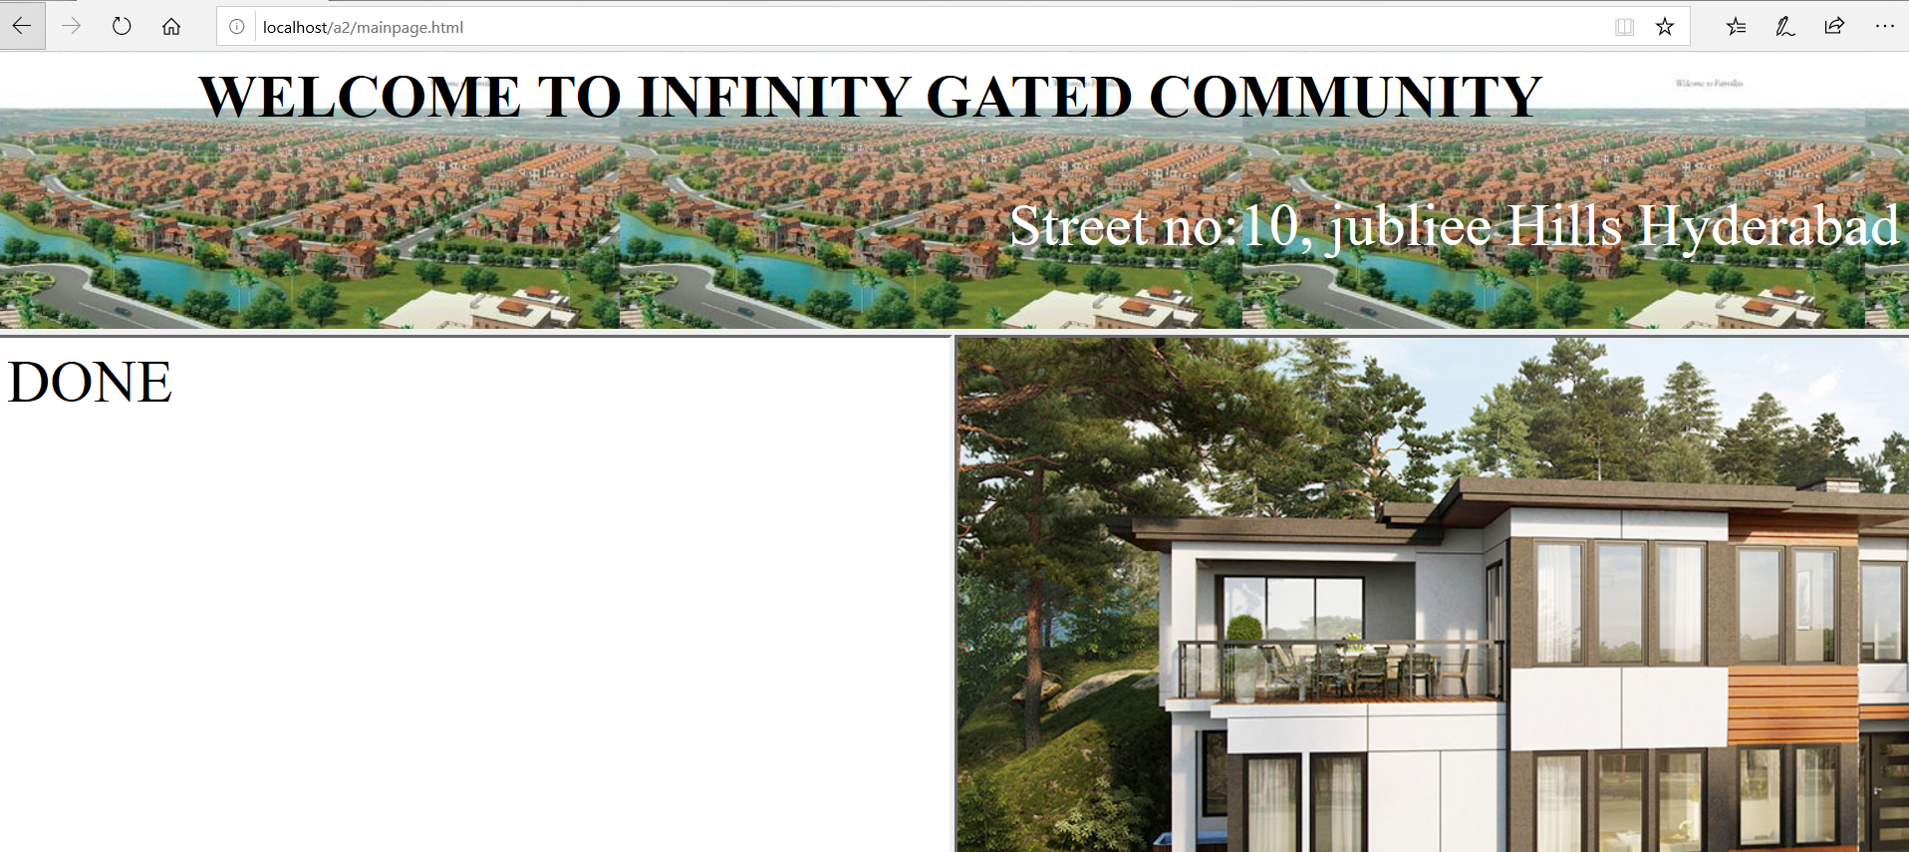

Slide 29
MEETINGS/ Proposals page

Slide 30
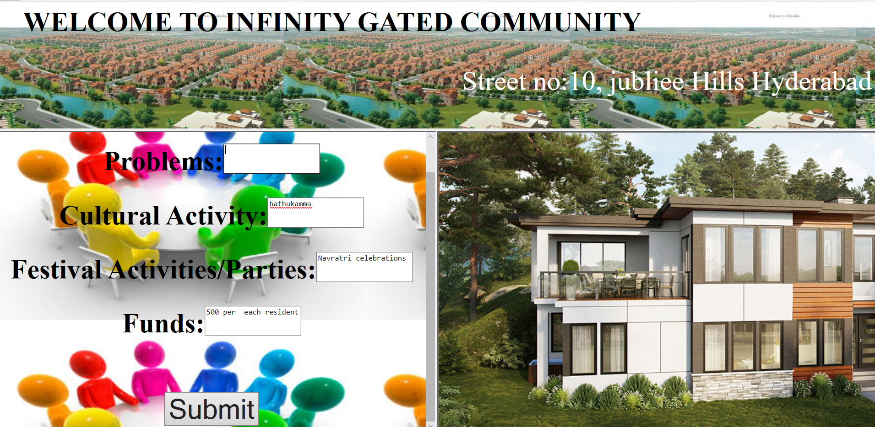

Slide 31
In this page a resident can propose meetings for cultural/festival celebrations or collect funds or any other issues and if the proposals are registered the message “done” is being displayed.

Slide 33


